Slide 1
MALLA REDDY UNIVERSITY
MR22-1CS0141:
DESIGN AND ANALYSIS OF ALGORITHMS
II YEAR B.TECH. (CSE) / I - SEM
(MRU - R22)
UNIT-I

Slide 2
UNIT- I
Introduction: Characteristics of an Algorithm, Specification of Algorithms - Pseudo-Code Conventions, Performance analysis- Space complexity, Time Complexity, Asymptotic notations- Big oh notation, omega notation, theta notation and little oh notation, Algorithm Design Techniques.
Divide and Conquer: Divide and Conquer General method, Applications of Divide and Conquer – Binary search algorithm, Analysis of Binary search, Merge sort algorithm, Analysis of Merge sort, Quick sort algorithm, Analysis of Quick sort.

Slide 3
ALGORITHM
An algorithm is a finite sequence of instructions, each of which has a clear meaning and can be performed with a finite amount of effort in a finite length of time to perform a particular task.
An algorithm is an effective step-by-step procedure for solving a problem in a finite number of steps.

Slide 4
Characteristics of Algorithm
1. Input: Zero or more quantities are externally supplied.
2. Output: At least one quantity is produced.
3. Definiteness: Each instruction must be unambiguous.
4. Finiteness: The algorithm will terminate after a finite number of steps.
5. Effectiveness: Every instruction must be sufficiently basic.

Slide 5
Example of an Algorithm
Algorithm : Calculation of Simple Interest
Step 1: Start
Step 2: Read principle (P), time (T) and rate (R)
Step 3: Calculate I = P*T*R/100
Step 4: Print I as Interest
Step 5: Stop

Slide 6
Algorithm for sum of 2 numbers
Step 1 : Start
Step 2 : Read num1,num2
Step 3 : Sum = num1 + num2
Step 4 : Print Sum
Step 5 : Stop

Slide 7
Advantages of an Algorithm
Effective Communication: It is simple to understand step-by-step solution of the problems.
Easy Debugging: Well-designed algorithm makes debugging easy so that we can identify logical error in the program.
Easy and Efficient Coding: An algorithm acts as a blueprint of a program and helps during program development.
Independent of Programming Language: Can be easily coded using any high level language.

Slide 8
Disadvantages of an Algorithm
Developing algorithm for complex problems would be time consuming and difficult to understand.
Understanding complex logic through algorithms can be very difficult.

Slide 9
Representation of Algorithm
Natural English language
Programming language
Flow chart
Pseudo code

Slide 10
Programming language
C program for sum of 2 numbers
#include <stdio.h>
int main()
{
int num1, num2, sum;
printf("Enter first number: ");
scanf("%d", &num1);
printf("Enter second number: ");
scanf("%d", &num2);
sum = num1 + num2;
printf("Sum of the entered numbers: %d", sum);
return 0;
}

Slide 11
Java program for sum of 2 numbers
import java.util.Scanner;
public class AddTwoNumbers2
{
public static void main(String[] args)
{
int num1, num2, sum;
Scanner sc = new Scanner(System.in);
System.out.println("Enter First Number: ");
num1 = sc.nextInt();
System.out.println("Enter Second Number: ");
num2 = sc.nextInt();
sc.close();
sum = num1 + num2;
System.out.println("Sum of these numbers: "+sum);
}
}

Slide 12
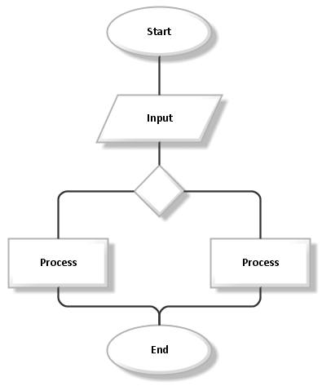
Flow chart Pictorial representation of algorithm

Slide 13
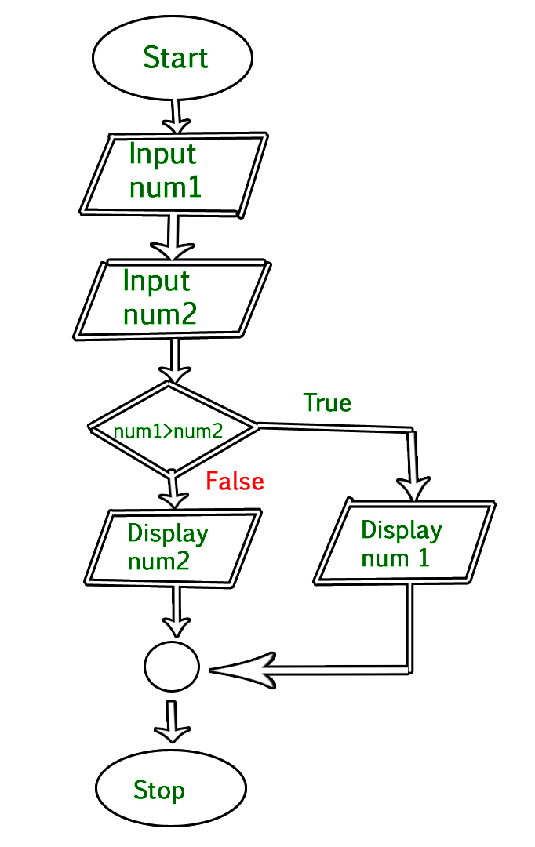
Example of Flow chart

Slide 14
Pseudo code
Pseudo code is an artificial and informal language that helps programmers to develop algorithms.
Pseudo code is a "text-based" detail design tool.
Example:
If student's grade is greater than or equal to 60
Print "pass"
else
Print "fail"

Slide 15
Advantages of Pseudo code
Improves the readability of any approach.
Acts as a bridge between the program and the algorithm or flowchart.
Also works as a rough documentation.
The main goal of a pseudo code is to explain what exactly each line of a program should do, hence making the code construction phase easier for the programmer.

Slide 16
Pseudocode consists of ,
1. Single line comments start with //
2. Multi-line comments occur between /* and */
3. Blocks are represented using brackets. Blocks can be used to represent compound statements or the procedures.
{ statements }
4. Statements are delimited by semicolon.
5. Assignment statements indicates that the result of evaluation of the expression will be stored in the variable.
< variable > := < expression >
6. The Boolean expression 'x > y' returns true if x is greater than y, else returns false.
7. if< condition >then< statement >

Slide 17
8. This condition is an enhancement of the above 'if' statement. It can also handle the case where the condition isn't satisfied.
if< condition >then< statement1 >else< statement2 >
9. switch case (C or C++)
case { :< condition 1 >: < statement 1 > ..... ..... ..... :< condition n >: < statement n > :default: < statement n+1 > }
10. while loop
while< condition > { statements; }

Slide 18
11. do-while loop
repeat statements; until< condition >
12. for loop
for variable: = value1 to value2 { statements; }
13. input instruction
Read
14. Output instruction
Print
15. The name of the algorithm is < name > and the arguments are stored in the < parameter list >
Algorithm< name > (< parameter list >)

Slide 19
Example:
1. Algorithm Sum()
2. // Calculate the sum of 2 numbers
3. {
4. Declare num1,num2 and sum;
5. Read num1,num2;
6. sum:= num1 + num2;
7. Print sum;
8. }

Slide 20
Example:
1. Algorithm Max(A,n)
2. // A is an array of size n
3. {
4. Result := A[0];
5. for I:= 1 to n-1 do
6. if A[I] > Result then
7. Result :=A[I];
8. return Result;
9. }

Slide 21
Example: Write an algorithm to count the Sum of n numbers.
Algorithm Sum(1,n) // Count the Sum of n numbers
{
result : = 0;
for i: =1 to n do
result : = result + i;
i: = i+1;
}

Slide 22
Example: Write an algorithm to check whether given number is even or odd.
Algorithm Even(val) // Check the given number is odd or even
{
if ( val % 2 = = 0)
then
write (“Given number is even”);
else
write (“Given number is odd”);
}

Slide 23
Example: Write an algorithm for sorting the elements.
Algorithm Sort(a,n) // Sorting the elements
{
for i : = 1 to n do
for j : = i+1 to n-1 do
{
if(a[i]>a[j]) then
{
temp : = a[i];
a[i] : = a[j];
a[j] : = temp;
}
}
write (“Elements are sorted”);
}

Slide 24
Example: Write an algorithm to find the factorial of n number.
Algorithm Fact(n) // Find the factorial of n number. { if ( n = = 1) then return 1; else return (n * Fact(n-1)); } | Algorithm Fact(n) // Find the factorial of n number. { fact : = 1; for i : = 1 to n do fact : = fact * i; write (“Factorial is :”, fact); }

Slide 25
Example: Write an algorithm to perform multiplication of two matrices.
Algorithm Mul(A,B,n) // Multiplication of two matrices
{
for i : = 1 to n do
for j : =1 to n do
C[i, j] : = 0;
for k : = 1 to n do
C[i, j] : = C[i, j]+ A[i, k] * B[k, j];
}

Slide 26
Difference between algorithm, pseudo code and program
Parameters | Algorithm | Pseudocode | Program
Meaning and Definition | An algorithm is a well-defined, systematic logical approach that comes with a step-by-step procedure for computers to solve any given program. | It is basically a simplified version of the programming codes. These codes exist in the plain English language, and it makes use of various short phrases for writing a program code before implementing it in any programming language. | It refers to the code (written by programmers) for any program that follows the basic rules of the concerned programming language.
Expression and Use | We can express algorithms using flowcharts, natural language, and many more. | You get to include various control structures using pseudocode, such as repeat-until, if-then-else, while, for and case. | No device can directly read a program. Instead, you can write anything in a computer language and then use a compiler or interpreter (for compiling and interpreting) so that it becomes understandable for any computer system.

Slide 27
Performance Analysis
Performance of an algorithm is a process of making evaluative judgment about algorithms.
Performance of an algorithm means predicting the resources which are required to an algorithm to perform its task.
Performance analysis of an algorithm is the process of calculating space and time required by that algorithm.

Slide 28
Performance Analysis
The performance of an algorithm depends on the following elements...
Whether that algorithm is providing the exact solution for the problem?
Whether it is easy to understand?
Whether it is easy to implement?
How much space (memory) it requires to solve the problem?
How much time it takes to solve the problem? Etc.,

Slide 29
Time complexity
The time complexity of an algorithm is the total amount of time required by an algorithm to complete its execution.
To calculate the time complexity of an algorithm,
It requires 1 unit of time for Arithmetic and Logical operations
It requires 1 unit of time for Assignment and Return value
It requires 1 unit of time for Read and Write operations

Slide 30
Time complexity
Example
int sum(int a, int b)
{
a=5;
b=6;
c=a+b;
}
It requires 1 unit of time for a=5, 1 unit of time for b=6 and 1 unit of time to calculate c=a+b.
Totally it takes 3 units of time to complete its execution.
so, T(n)=3

Slide 31
Space complexity
Total amount of computer memory required by an algorithm to complete its execution is called as space complexity of that algorithm.
Instruction Space: It is the amount of memory used to store compiled version of instructions.
Environmental Stack: It is the amount of memory used to store information of partially executed functions at the time of function call.
Data Space: It is the amount of memory used to store all the variables and constants.

Slide 32
Space complexity
Example
int sum(int a, int b)
{
a=5;
b=6;
c=a+b;
}
It requires 1 word space for a variable a, 1 word space for a variable b and 1 word space a variable c.
Totally it takes 3 word spaces to complete its execution.
so, S(n)=3

Slide 33
Space complexity
To calculate the space complexity, we must know the memory required to store different data type values (according to the compiler).
For example, the C Programming Language compiler requires the following...
2 bytes to store Integer value.
4 bytes to store Floating Point value.
1 byte to store Character value.
6 (OR) 8 bytes to store double value.

Slide 34
Space complexity
Example
int square(int a)
{
return a*a;
}
In the above piece of code, it requires 2 bytes of memory to store variable 'a' and another 2 bytes of memory is used for return value.
That means, totally it requires 4 bytes of memory to complete its execution. And this 4 bytes of memory is fixed for any input value of 'a.

Slide 35
Frequency count method / Step count
For comments, declaration step count is 0
Return, Assignment count is 1
Ignore constant multiplier
Ignore lower order exponent when higher order exponent is present
Example:
f(n)=10n⁸
Then, f(n)=O(n⁸)
f(n)=5n⁵+4n³
Then, f(n)=O(n⁵)

Slide 36
Frequency count method / Step count
Algorithm sum(A,n)
{
s=0;
for(i=0;i<n;i++)
{
s=s+A[i];
}
return s;
}
Time complexity:
T(n)=1+(n+1)+n+1
=2n+3
Hence, T(n) = O(n)

Slide 37
Frequency count method / Step count
Algorithm sum(A,n)
{
s=0;
for(i=0;i<n;i++)
{
s=s+A[i];
}
return s;
}
Space complexity:
S(n)=n+1+1+1
=n+3
Hence, S(n) = O(n)

Slide 38
Frequency count method / Step count
Algorithm matrixSum(int a[][],int b[][])
{
int c[][];
for(i=0;i<n;i++)
{
for(j=0;j<n;j++)
{
c[i][j]=a[i][j]+b[i][j];
}
} }

Slide 39
Frequency count method / Step count
Time complexity:
T(n)=(n+1)+n*(n+1)+n*n
=2n²+2n+1
Hence, T(n) = O(n²)
Space complexity:
S(n)=n²+n²+n²+1+1
=3n²+2
Hence, S(n) = O(n²)

Slide 40
Types of time functions
The most common computing times are:
Lower Bound
O(1) - Constant
O(log₂n) - Logarithmic
√n
Average Bound
O(n) - Linear
Upper Bound
O(nlog₂n) - Logarithmic
O(n²) - Quadratic
O(n³) - Cubic
O(2^{n}) - Exponential
O(3^{n}),
O(n^{n})

Slide 41
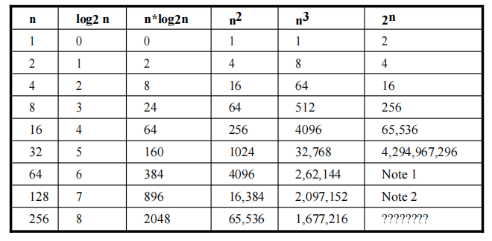
Numerical Comparison

Slide 42
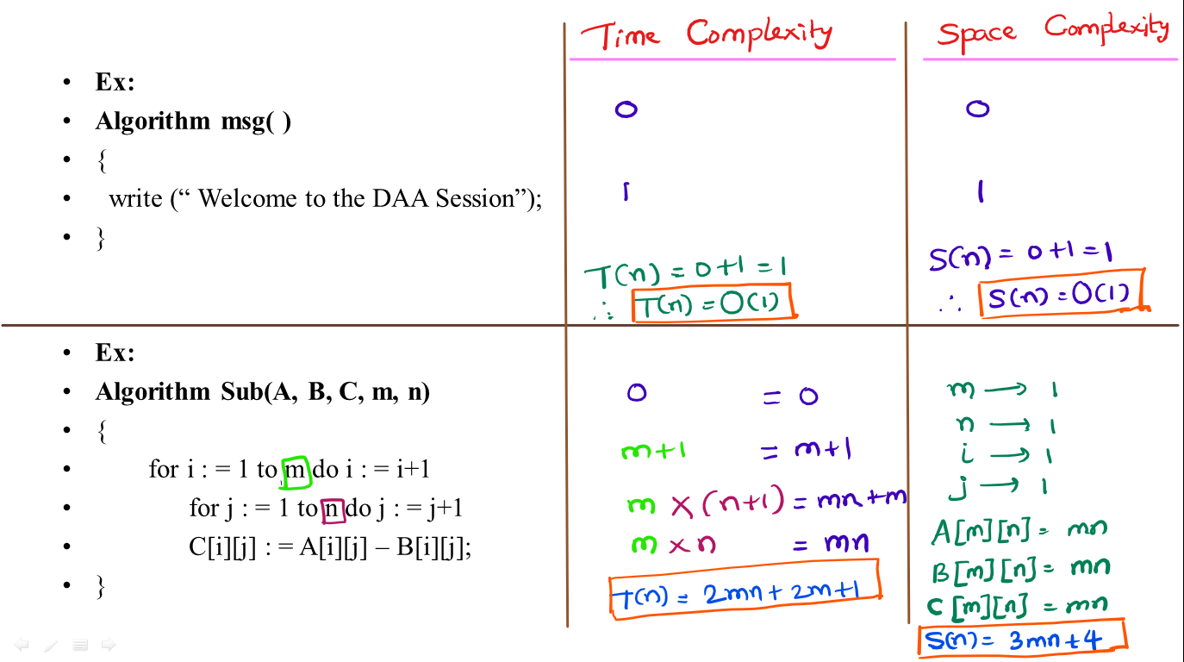

Slide 43
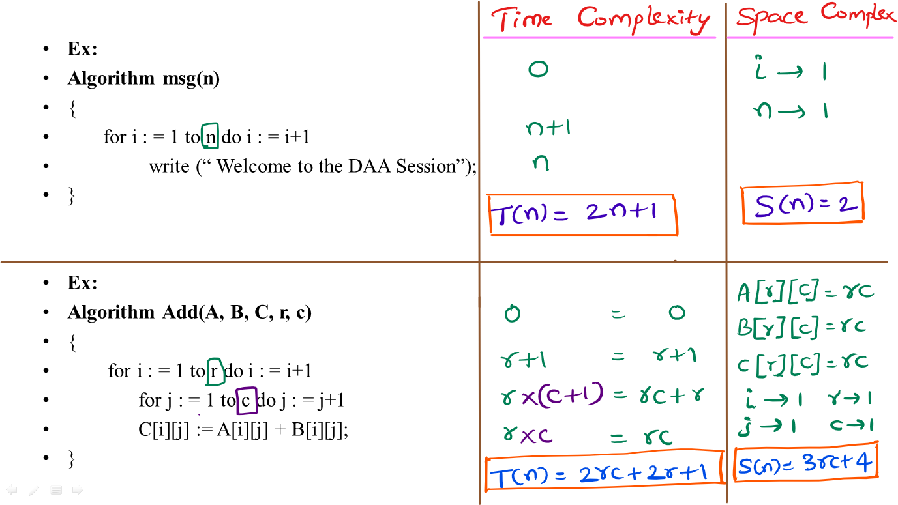

Slide 44
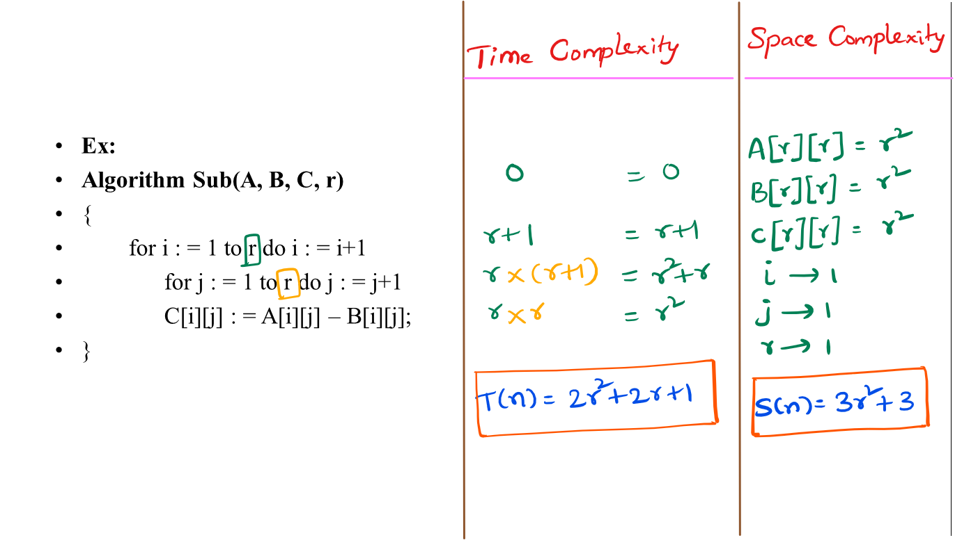

Slide 45
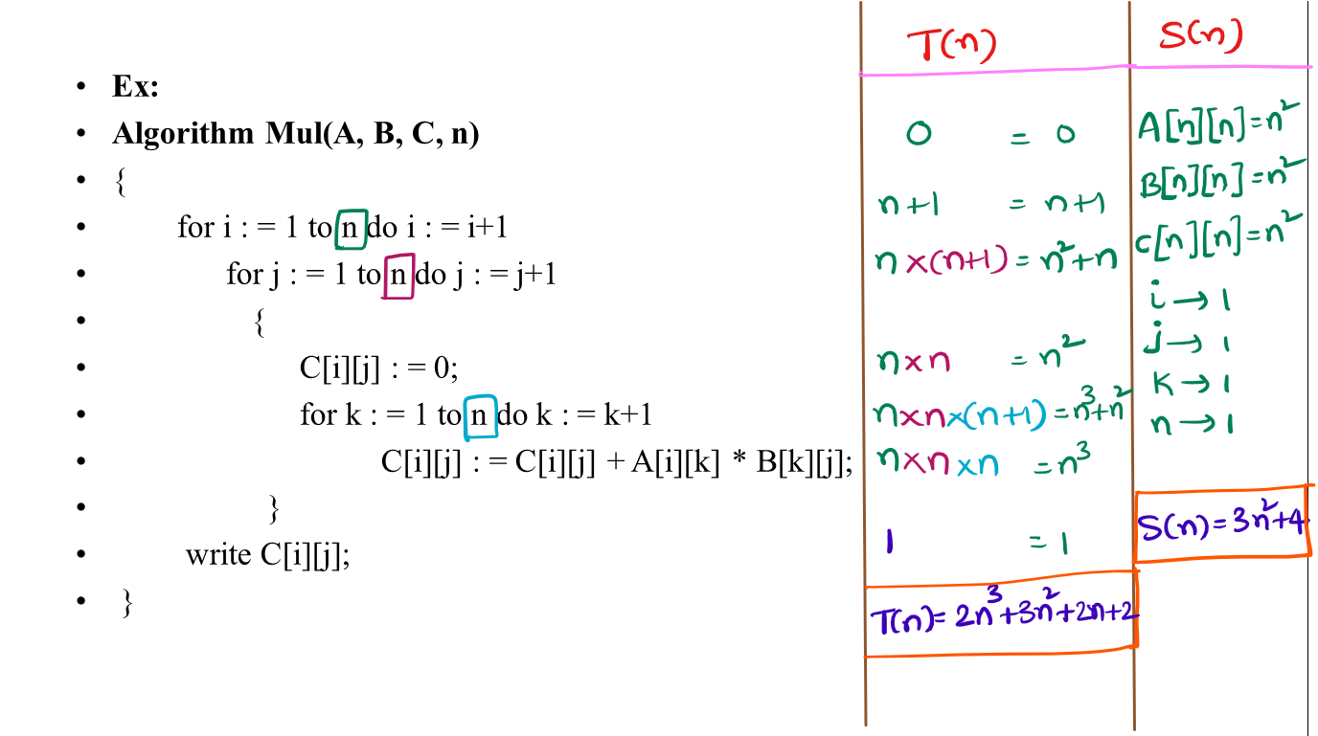

Slide 46
Complexity of Algorithms
The complexity has three cases,
1. Best Case
2. Average Case
3. Worst Case
The complexity function f(n) for certain cases are:
1. Best Case : The minimum possible value of f(n) is called the best case.
2. Average Case : The expected value of f(n).
3. Worst Case : The maximum value of f(n) for any key possible input.

Slide 47
Best Case Analysis
In the best case analysis, we calculate lower bound on running time of an algorithm.
We must know the case that causes minimum number of operations to be executed.
Example:
In the linear search problem, the best case occurs when x is present at the first location.
The number of operations in the best case is constant (not dependent on n).
So time complexity in the best case would be O(1).

Slide 48
Worst Case Analysis
In the worst case analysis calculate upper bound on running time of an algorithm.
We must know the case that causes maximum number of operations to be executed.
Example:
For Linear Search, the worst case happens when the element to be searched (x in the above code) is not present in the array.
Therefore, the worst case time complexity of linear search would be O(n).

Slide 49
Average Case Analysis
Average case analysis takes all possible inputs and calculate computing time for all of the inputs.
Sum all the possible cases and divide the sum by total number of cases.
Example:
For the linear search problem, let us assume that all cases are uniformly distributed (including the case of x not being present in array).
So we sum all the cases n(n+1)/2 and divide the sum by n.
Therefore, the average case time complexity of linear search would be (n+1)/2.

Slide 50
Asymptotic Notations
Asymptotic notations are the mathematical notations used to describe the running time of an algorithm when the input tends towards a particular value or a limiting value.
There are mainly three asymptotic notations:
Big-O notation
Omega notation
Theta notation

Slide 51
Big-O Notation (O-notation)
Big-O notation represents the upper bound of the running time of an algorithm. Thus, it gives the worst-case complexity of an algorithm.
For any value of n, the maximum time required by the algorithm is given by Big-O O(g(n)).
A function f(n) belongs to the set O(g(n)) if there exists a positive constant c and n₀ such that ,
f(n) ≤c*g(n) for all n ≥ n₀

Slide 52
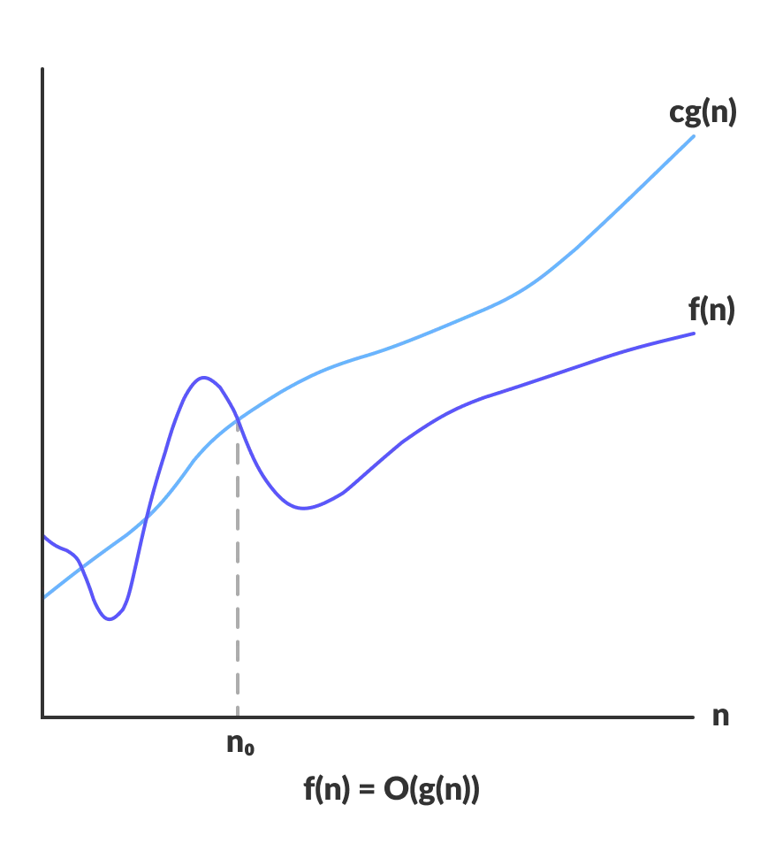
Big-O Notation (O-notation)

Slide 53
Big-O Notation
1)The function 3n+2 = O(n) as 3n+2 ≤ 6n for all n ≥ 1.
2) 3n+2 = O(n) as 3n+2 ≤ 4n for all n ≥ 2.
3) 3n + 3 = O(n) as 3n + 3 ≤ 4n for all n ≥ 3.
4)lOOn+ 6 = O(n) as lOOn+6≤ 101n for all n≥6.
5) 10n2+4n+2 = O(n2) as 10n2+4n+2 ≤11n2 for all n ≥5.

Slide 54
Omega Notation (Ω-notation)
Omega notation represents the lower bound of the running time of an algorithm.
For any value of n, the minimum time required by the algorithm is given by Omega Ω(g(n)).
A function f(n) belongs to the set Ω(g(n)) if there exists a positive constant c and n₀ such that,
f(n) ≥ c * g(n) for all n, n ≥ n₀

Slide 55
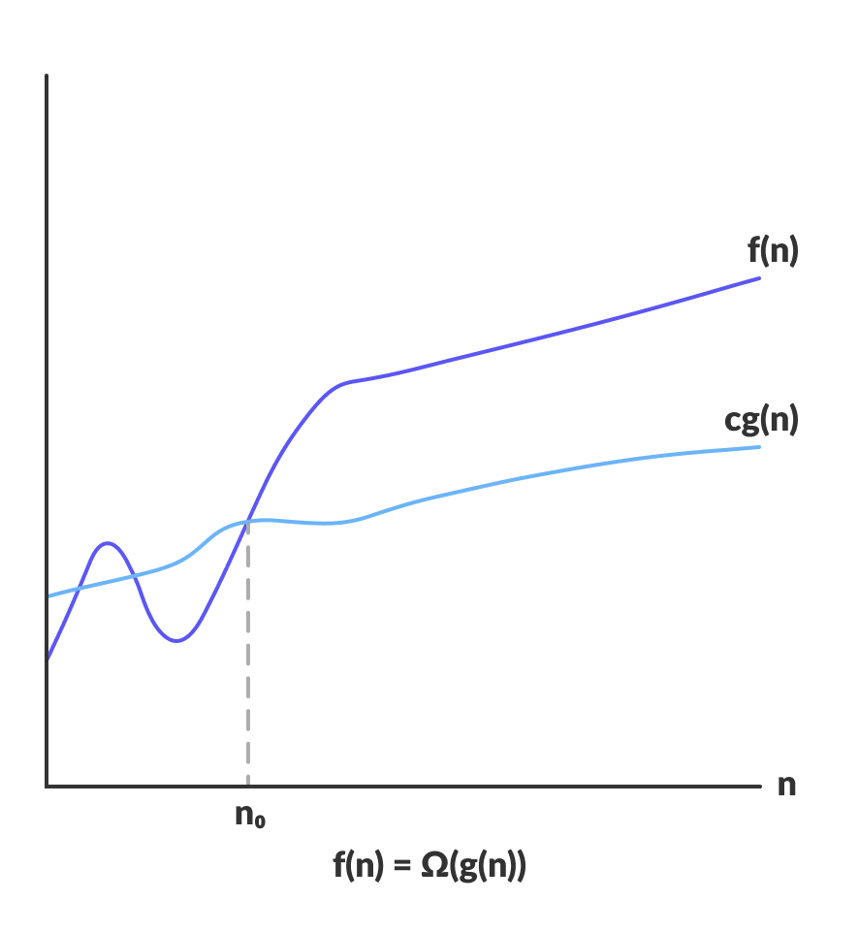
Omega Notation (Ω-notation)

Slide 56
Omega Notation (Ω-notation)
The function 3n + 2 = Ω (n) as 3n + 2 ≥ 3n for all n ≥ 1
3n+3 = Ω (n) as 3n+3 ≥ 3n for all n ≥ 1.
100n+6 = Ω(n) as 100n+6 ≥ lOOn for all n ≥ 1.
10n2+ 4n + 2 = Ω(n2) as 10n2+ 4n + 2 ≥ n2 for n ≥ 1.

Slide 57
Theta Notation (Θ-notation)
Theta notation encloses the function from above and below. Since it represents the upper and the lower bound of the running time of an algorithm.
For any value of n, the average time required by the algorithm is given by Theta Θ(g(n)).
A function f(n) belongs to the set Θ(g(n)) if there exists a positive constant c₁, c₂ and n₀ such that,
c₁g(n) ≤ f(n) ≤ c₂g(n) for all n ≥ n₀
If a function f(n) lies anywhere in between c₁g(n) and c₂g(n) for all n ≥ n0, then f(n) is said to be tight bound.

Slide 58
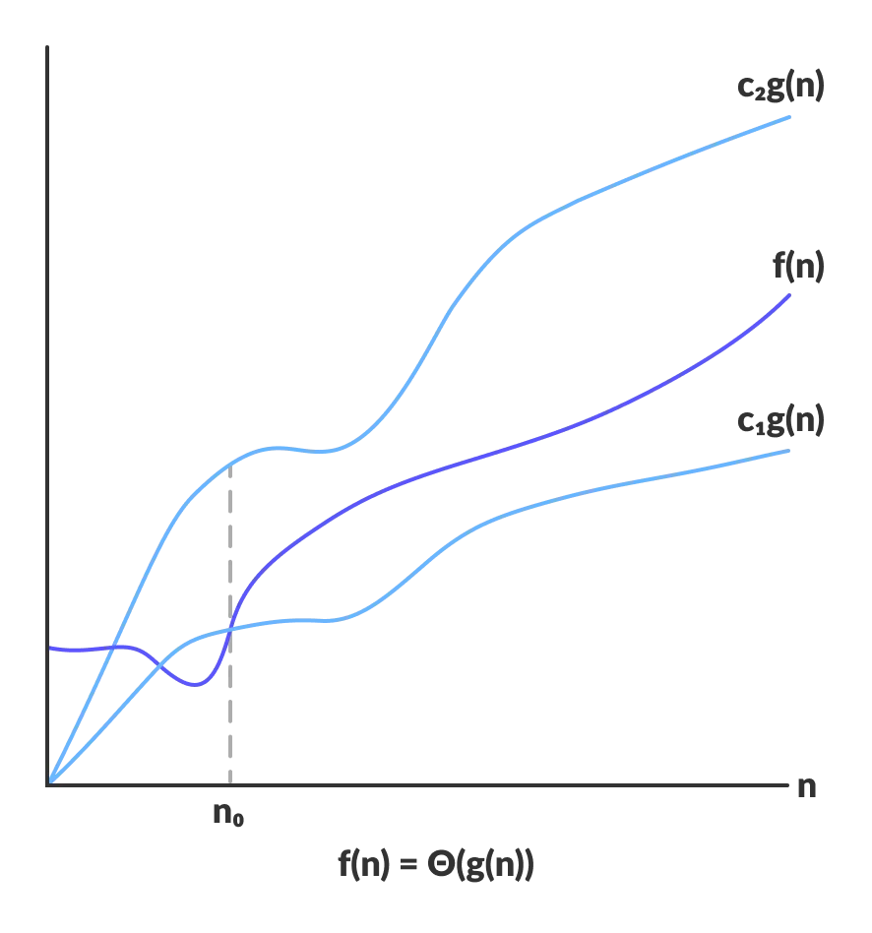
Theta Notation (Θ-notation)

Slide 59
Theta Notation (Θ-notation)
The function 3n+2 = Θ(n)
as 3n+2 ≥ 3n for all n ≥ 2 and 3n+2 ≤ 4n for all n ≥ 2,
so c1 = 3, C2= 4, and no = 2.
So 3n ≤ 3n+2 ≤ 4n

Slide 60
Big-O, Omega and Theta Notation
f(n)=4n²+2, 4n²+2 ≤ 10n²
f(n)=4n²+2, 4n²+2 ≥ n²
f(n)=4n²+2, n² ≤ 4n²+2 ≤ 10n²
f(n)=n²logn+n, n²logn ≤ n²logn+n ≤ 10n²logn
f(n)=n!, 1 ≤ n! ≤ n^{n}
f(n)=log n!, 1 ≤ log n! ≤ log n^{n}

Slide 61

Little o Notation
Little o notation is used to describe an upper bound that cannot be tight. In other words, loose upper bound of f(n).
Let f(n) and g(n) are the functions that map positive real numbers. We can say that the function f(n) is o(g(n)) if for any real positive constant c, there exists an integer constant n0 ≤ 1 such that f(n) > 0
we can say that f(n) = o(g(n)) means,

Slide 62
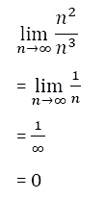
Little o Notation

Slide 63
Recursion
Types of Recursion: A function calling itself is called recursion
Linear Recursion
Tree Recursion
Linear Recursion:
A function that only makes a single call to itself each time the function runs.
function calculate(n) {
if n > 0:
{
print n;
calculate(n-1);
} }
Tree Recursion:
A phrase to describe when you make a recursive call more than once in your recursive case.
function calculate(n) {
if n > 0:
{
print n;
return calculate(n-1) + calculate(n-2);
} }

Slide 64
Recursive Tree
function calculate(n) {
if n > 0:
{
print n;
calculate(n-1);
} }
Find the Time complexity:
Time taken for print: n
Time taken for function calls: n+1
Total Time: n+(n+1) = 2n+1
Time Complexity, T(n)=O(n)

Slide 65
Recurrence Relation
function calculate(n) {
if n > 0:
{
print n;
calculate(n-1);
} }
Recurrence Relation:
T(n)=T(n-1)+1
T(n)= ｛1 n=0
｛T(n-1)+1 n>0

Slide 66
Recurrence Relation
Solve:
By substitution method,
T(n)=T(n-1)+1
T(n-1)=T(n-1-1)+1 = T(n-2)+1
T(n-2)=T(n-2-1)+1 = T(n-3)+1
T(n-3)=T(n-3-1)+1 = T(n-4)+1
Hence, T(n)=T(n-1)+1
T(n)=T(n-2)+1+1 = T(n-2)+2
T(n)=T(n-3)+1+1+1= T(n-3)+3
T(n)=T(n-4)+1+1+1+1= T(n-4)+4.......
At K^{th} step, T(n)=T(n-k)+k

Slide 67
Recurrence Relation
Assume, n-k=0
n=k
sub, n=k
T(n)=T(n-n)+n
T(n)=T(0)+n
T(n)=1+n
T(n)=O(n)

Slide 68
Recurrence Relations
T(n)=T(n-1)+1 - O(n)
T(n)=T(n-1)+n - O(n²)
T(n)=T(n-1)+logn - O(nlogn)
T(n)=2T(n-1)+1 - O(2^{n})
T(n)=3T(n-1)+1 - O(3^{n})
T(n)=2T(n-1)+n - O(n2^{n})

Slide 69
Divide and conquer
A divide and conquer algorithm is a strategy of solving a large problem by breaking the problem into smaller sub-problems,
solving the sub-problems, and combining them to get the desired output.
Steps:
Divide: Divide the given problem into sub-problems. The sub problems are solved recursively.
Conquer: Combine the solutions of the sub-problems that are part of the recursive process to solve the original problem.

Slide 70
General method
DANDC (P)
{
if SMALL (P) then S (p);
else
{
divide p into smaller instances p1, p2, …. Pk, k ≥1;
apply DANDC to each of these sub problems;
COMBINE(DANDC(p1), DANDC(p2),..., DANDC(pk));
} }
where P is the problem to be solved.

Slide 71
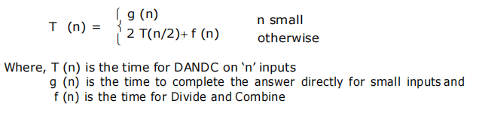
General method
If the sizes of the two sub problems are approximately equal then the computing time of DANDC is:

Slide 72
Master’s theorem
Master theorem
Master theorem states that for a recurrence relation of form,
T(n)=aT(n/b)+f(n) ,
where a >=1 and b >1
There are the following three cases:
If f(n) = O(n^{c}) where c < Log_{b}a then T(n) = Θ(n^{Log}_{b}ª)
If f(n) = Θ(n^{c}) where c = Log_{b}a then T(n) = Θ(n^{c}Log n)
If f(n) = Ω(n^{c}) where c > Log_{b}a then T(n) = Θ(f(n))

Slide 73
Divide and Conquer Applications
Binary Search
Merge Sort
Quick Sort
Strassen's Matrix multiplication
Finding the maximum and minimum of a sequence of numbers.

Slide 74
Binary Search
searching algorithm used in a sorted array by repeatedly dividing the search interval in half.
The basic steps to perform Binary Search are:
Sort the array in ascending order.
Set the low index to the first element of the array and the high index to the last element.
Set the middle index to the average of the low and high indices.
If the element at the middle index is the target element, return the middle index.
If the target element is less than the element at the middle index, set the high index to the middle index – 1.
If the target element is greater than the element at the middle index, set the low index to the middle index + 1.
Repeat steps 3-6 until the element is found or it is clear that the element is not present in the array.

Slide 75
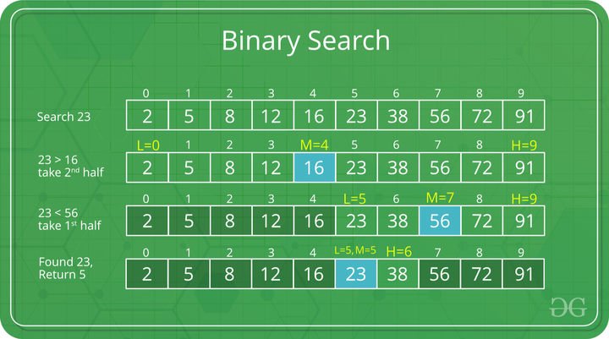
Binary Search
Illustration :

Slide 76
Binary Search
Binary Search Algorithm can be implemented in the following two ways
Iterative Method
Recursive Method
Iterative Method:
binarySearch(arr, key, low, high)
repeat till low <= high
mid = (low + high)/2
if (key == arr[mid])
return mid
else if (key > arr[mid]) // key is on the right side
low = mid + 1
else // key is on the left side
high = mid - 1

Slide 77
Binary Search
Recursive Method:
binarySearch(arr, key, low, high)
if low > high
return False
else
mid = (low + high) / 2
if key== arr[mid]
return mid
else if key > arr[mid] // key is on the right side
return binarySearch(arr, key, mid + 1, high)
else // key is on the left side
return binarySearch(arr, key, low, mid - 1)

Slide 78
Binary Search
Iterative Method:
Total number of elements in array = 7
Maximum comparison depends on the height of the tree.
Height of the tree = logn
Recurrence relation, T(n)=T(n/2)+1
Time Complexity:
Minimum time is 1 and Maximum time is logn
Best case = O(1) , Element to be searched is at Root
Average case= O(logn), All possible cases of search
Worst case= O(logn), Element to be searched is not in the list
2 | 5 | 9 | 16 | 18 | 36 | 52

Slide 79
Merge sort
Merge sort algorithm is a classic example of divide and conquer
Given a sequence of ‘n’ elements a[1],…,a[n] the general idea is to split into 2 sets a[1],…..,a[n/2] and a[[n/2]+1],….a[n].
Each set is individually sorted, and the resulting sorted sequences are merged to produce a single sorted sequence of ‘n’ elements.

Slide 80
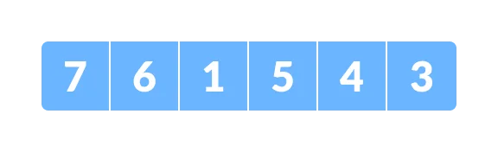
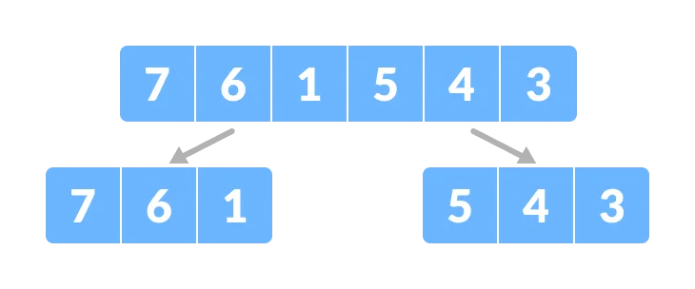
Merge sort
Divide the array into two halves.

Slide 81
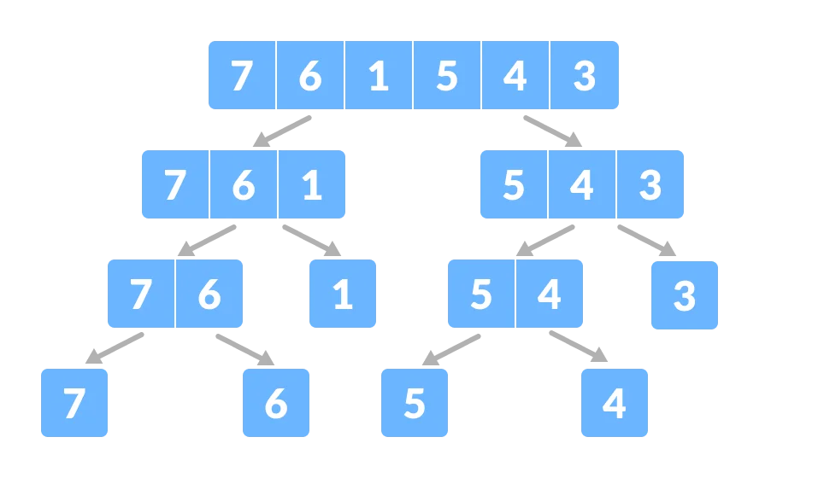
Merge sort

Slide 82
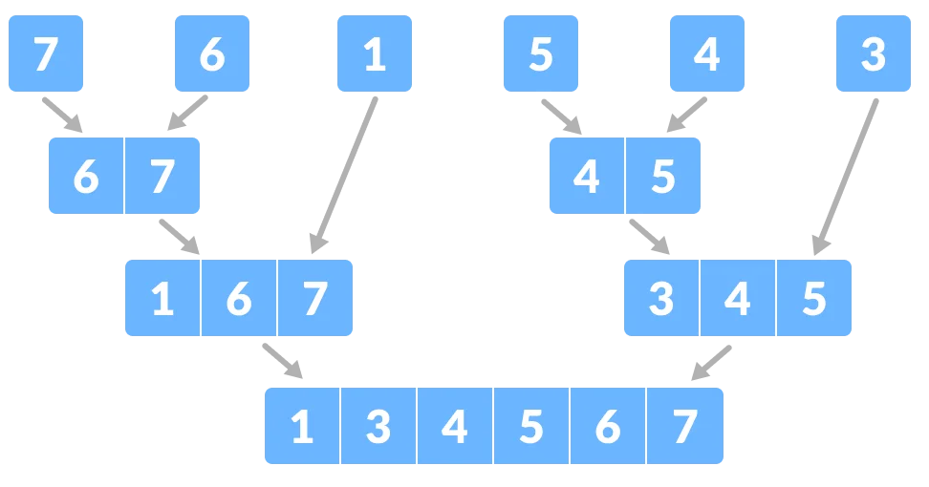
Merge sort

Slide 83
Algorithm For Merge Sort
Algorithm MergeSort(Array[],low,high)
{
if (low<high) then
{
mid = [(low+high)/2];
//divide the subproblems
mergesort (Array[],low,mid);
mergesort(Array[],mid+1,high);
//combine the solutions
merge(Array[],low,mid,high);
}}

Slide 84
Algorithm MERGE (Array[],low, mid, high)
{
int a[]=Array[mid - low],
int b[]=Array[high - mid+1];
i=0,j=0,k=0;
while(i<=m && j<=n)
{
if(a[i]<b[j])
c[k++]:=a[i++];
else
c[k++]:=b[j++];
}
for(;i<m;i++)
c[k++]:=a[i];
for(;j<n;j++)
c[k++]:=b[j];
}

Slide 85
Time complexity of merge sort
T(n) = 2T(n/2) + n-1
Where,
a = 2 (each time, a problem is divided into 2 sub problems)
n/b = n/2 (size of each sub problem is half of the input)
f(n) = time taken to divide the problem and merging the sub problems
T(n/2) = O(n log n)
Now, T(n) = 2T(n log n) + O(n) ≈ O(n log n)

Slide 86
Time complexity & space complexity
Best Case Complexity: O(n*log n) for the already sorted array.
Average Case Complexity: O(n*log n), which happens when 2 or more elements are jumbled, i.e., neither in the ascending order nor in the descending order.
Worst Case Complexity: O(n*log n), which occurs when we sort the descending order of an array into the ascending order.
Space Complexity: The space complexity of merge sort is O(n)

Slide 87
Merge Sort Applications
The concept of merge sort is applicable in the following areas:
Inversion count problem
External sorting
E-commere applications

Slide 88
Quick Sort Algorithm
In Quick sort algorithm, partitioning of the list is performed using following steps...
Step 1 - Consider the first element of the list as pivot (i.e., Element at first position in the list).
Step 2 - Define two variables i and j. Set i and j to first and last elements of the list respectively.
Step 3 - Increment i until list[i] > pivot then stop.
Step 4 - Decrement j until list[j] < pivot then stop.
Step 5 - If i < j then exchange list[i] and list[j].
Step 6 - Repeat steps 3,4 & 5 until i > j.
Step 7 - Exchange the pivot element with list[j] element.

Slide 89
p
r
x = 6
6
10
5
8
13
3
2
11
i
j
6
10
5
8
13
3
2
11
scan
i
j
6
2
5
8
13
3
10
11
swap
i
j
Partition
example
6
2
5
8
13
3
10
11
scan
i
j
6
2
5
3
13
8
10
11
swap
i
j
6
2
5
3
13
8
10
11
scan
j
i
p
q
r
3
2
5
6
13
8
10
11
final swap

Slide 90
6
10
5
8
11
3
2
13
Quick sort
example
3
2
5
6
11
8
10
13
2
3
5
6
10
8
11
13
2
3
5
6
8
10
11
13
2
3
5
6
8
10
11
13

Slide 91
Quick Sort Algorithm
QUICKSORT (alist, start, end)
{
if end - start > 1:
p = partition(alist, start, end)
quicksort(alist, start, p)
quicksort(alist, p + 1, end)
}

Slide 92
Quick Sort Algorithm
PARTITION (alist, start, end)
{
pivot = alist[start];
i = start + 1;
j = end;
while (i<j):
{
while (alist[i] <= pivot):
i = i++;
while (alist[j] >= pivot):
j = j--;
if i <= j:
alist[i], alist[j] = alist[j], alist[i];
}
alist[start], alist[j] = alist[j], alist[start];
return j;
}

Slide 93
Time Complexity
Best Case : O (n log n) Average Case : O (n log n)
Worst Case : O(n²)
To sort a sorted list with 'n' number of elements, we need to make ((n-1)+(n-2)+(n-3)+......+1) = (n (n-1))/2 number of comparisons in the worst case.
Space Complexity of quick sort is O(n)

